Slide 1
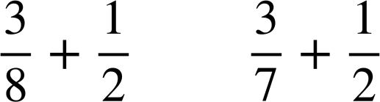
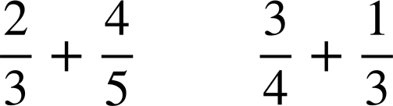
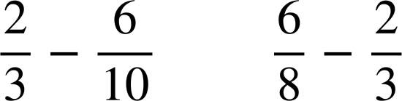


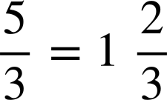



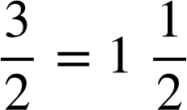

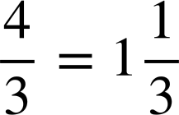
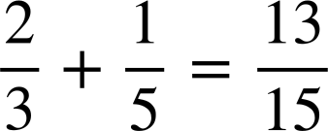
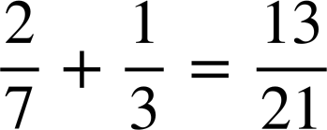
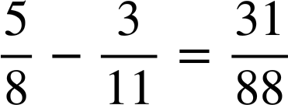
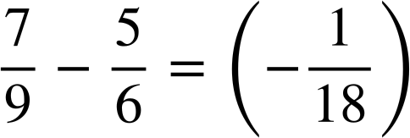
Checking understanding of addition and subtraction with fractions
Task A: Checking understanding of addition and subtraction
1) Place the symbols < or > into the following. Try to only work out the exact answer if it is not obvious.
a)
b)
c)
<
>
<
2) Find the missing value in each diagram. Give your answer in its simplest form.
?
ANSWERS
?
a)
d)
?
?
b)
e)
?
?
c)
f)
3) Find the missing digits.
a)
c)
b)
d)

Slide 2
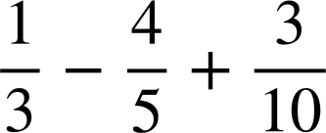
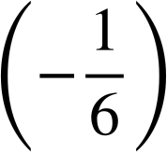
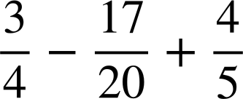

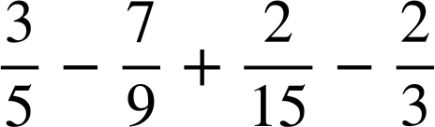
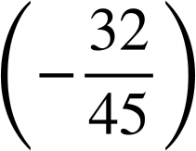
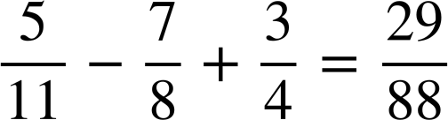
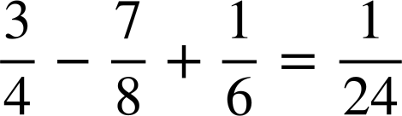

Checking understanding of addition and subtraction with fractions
Task B: Further understanding of addition and subtraction
Calculate the answers to the following:
a)
b)
c)
2) Find the missing digits in the following:
a)
b)
c)
Mathematics in Education and Industry
v2.2

